Slide 1
CATHODE RAY OSCILLOSCOPE

Slide 2
INTRODUCTION:
Cathode Ray Oscilloscope, Block diagram, Functions of each block

Slide 3
INTRODUCTION:
Cathode ray oscilloscope:
The cathode ray oscilloscope(CRO) is an electronic instrument that presents a high fidelity graphical display of the rapidly changing voltage at its input terminals. The cathode ray oscilloscope is probably the most versatile and useful instrument available for signal measurement.
Unlike meters, which only allow the user to measure amplitude information, the oscilloscope allows the user to view the instantaneous voltage versus time.
Such displayed plot of the signal can be used for various measurements like peak voltage, frequency, phase, time period, rise time etc. It can also indicate the nature and magnitude of noise that may be corrupting the measurement signal

Slide 4
INTRODUCTION:
The cathode-ray oscilloscope (CRO) is a multipurpose display instrument used for the observation, measurement , and analysis of waveforms by plotting amplitude along y-axis and time along x-axis.
CRO is generally an x-y plotter; on a single screen it can display different signals applied to different channels. It can measure amplitude, frequencies and phase shift of various signals.
Many physical quantities like temperature, pressure and strain can be converted into electrical signals by the use of transducers, and the signals can be displayed on the CRO.
A moving luminous spot over the screen displays the signal.
CROs are used to study waveforms, and other time-varying phenomena from very low to very high frequencies.
The central unit of the oscilloscope is the cathode-ray tube (CRT), and the remaining part of the CRO consists of the circuitry required to operate the cathode-ray tube.

Slide 6
Typically any existing CRO in a contemporary electronics laboratory would have two input channels (vertical Y channels: Y1 and Y2) along with an in-built X channel (horizontal) with a knob to vary the time quotient.
The signal that needs to be analyzed or studied is directly fed to any of the Y - channel (vertical) whereas the time function is available on the X - axis (horizontal) by default.
The two Y channels of the CRO allow measurement of two separate signals at any given point of time and their attributes including amplitude, time-period (frequency) studied or phase difference compared.
This type (most common) of CRO is popularly referred to as dual-trace CRO.

Slide 9
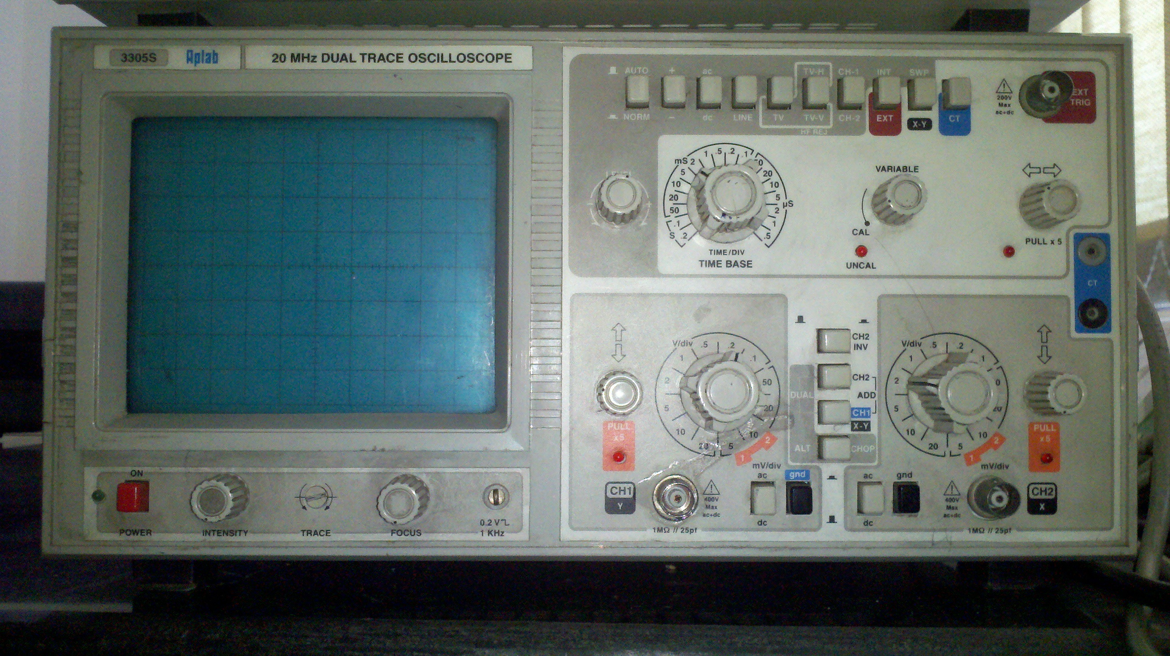

Slide 12
For what measurements can a CRO be used in the laboratory?
a) Calculating the frequency of a time-varying electronic signal.
b) Finding phase difference between two time-varying signals.
c) Tracing and trouble-shooting a malfunctioning component in a given circuit.
d) Visually see the signal “modifications” being carried out real-time by different electronic components in any given circuit.
e) Quantizing the amount of DC component in an AC signal and vice-versa.
f) Quantizing the amount of Noise in a Signal and its dependence on time.
g) Finding the type of signal under test e.g. sinusoidal, saw-tooth, triangular, rectangular etc.

Slide 13
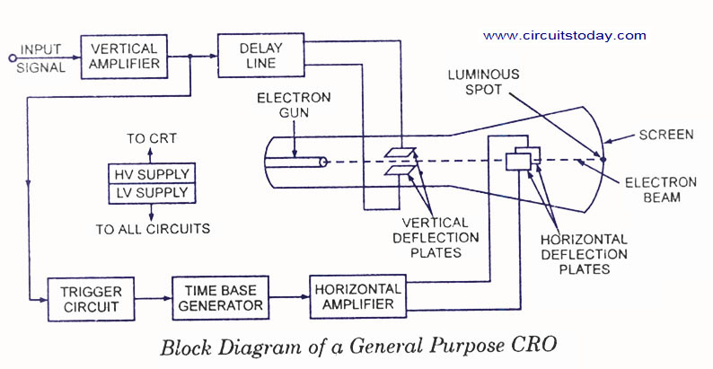

Slide 14
The more expensive models can measure signals at frequencies up to 500 MHz and even the cheapest models can measure signals at frequencies up to 20 MHz.
One particularly strong merit of the oscilloscopes its high input impedance, typically 1 Mohm, which means that the instrument has a negligible loading effect in most measurement situations.
As a test instrument, it is often required to measure voltages whose frequency and magnitude are totally unknown.

Slide 15
However, it is not a particularly accurate instrument and is best where only an approximate measurement is required.
Further disadvantages of oscilloscopes include their fragility and their moderately high cost.
There are two main classes of oscilloscopes: analog oscilloscopes and digital oscilloscopes.
A simplified block diagram of an analog oscilloscope is shown in below figure.

Slide 16
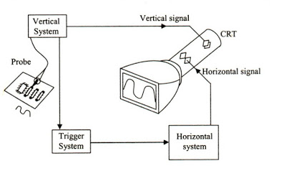

Slide 17
Cathode ray oscilloscopes use luminous spots which are produced by striking the beam of electrons and this luminous spot moves in response variation in the input quantity.
At this moment one question must be arise in our mind that why we are using only an electron beam?
The reason behind this is low effects of beam of electrons that can be used for following the changes in the instantaneous values of rapidly changing input quantity. The general forms of cathode ray oscilloscope operate on voltages.

Slide 18
So the input quantity that we have talked above is voltage. Nowadays, with the help of transducers it is possible to convert various physical quantities like current, pressure, acceleration etc to voltage thus it enable us to have a visual representations of these various quantities on cathode ray oscilloscope.
Now let us look at the constructional details of the cathode ray oscilloscope

Slide 19
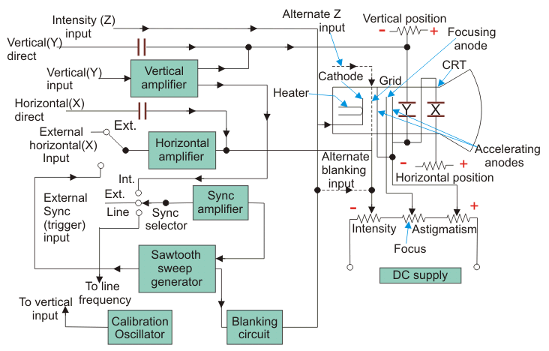
Block Diagram of CRO
Fig. 7.3 shows the block diagram of a CRO. As seen in the diagram, it consists of the following major sub-systems:

Slide 20
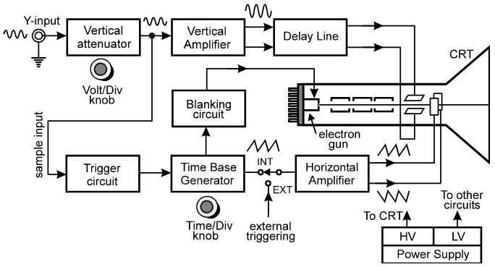
Block Diagram of CRO

Slide 21
COMPONENTS OF THE CATHODE-RAY OSCILLOSCOPE:
The CRO consists of the following:
Display
CRT
Vertical amplifier
Horizontal amplifier
Time-base generator
Triggering circuit
High and Low voltage supply
Delay line

Slide 22
Display.
In all the modern oscilloscopes it is usually LCD panel. In the old oscilloscopes the display was a cathode ray tube or CRT. The display whether LCD panel or CRT is laid out with both horizontal and vertical reference lines referred to as the graticule. In addition to the screen, most display sections are equipped with three basic controls, a focus knob, an intensity knob and a beam finder button.
2. Cathode Ray Tube (CRT). This is the cathode ray tube which emits electrons that strikes the phosphor screen internally to provide a visual display of signal. It displays the quantity being measured.
3. Vertical amplifier. It amplifies the signal waveform to be viewed. It is a wide band amplifier used to amplify signals in the vertical section. The gain of the amplifier is set by V/Div knob.
4. Delay Line. It is used to delay the signal for some time in the vertical sections

Slide 23
5. Horizontal amplifier. This is used to amplify the saw tooth voltage which is then applied to the X-plates.
6. Sweep generator. Produces saw tooth voltage waveform used for horizontal deflection of the electron beam.
Trigger circuit. Produces trigger pulses to start horizontal sweep. It converts the incoming signal into trigger pulses so that the input signal and the sweep frequency can be synchronized.
High and low. Voltage power supply.
High and low. Voltage power supply. Two voltages are generated in CRO
(a) The low voltage supply is from +300 to 400 V.
(b) The high voltage supply is from –1000 to –1500 V.

Slide 24
HORIZONTAL DEFLECTION SYSTEM (HDS)
Typically in any CRO, trigger circuit, time-base generator and horizontal amplifier together constitute the Horizontal Deflection System (HDS).
The main function of the HDS is to deflect horizontal portion of the trace at a constant rate as a function of time and which is a function of the input signal to be tested.

Slide 25
Brief description of the components of HDS:
a) Trigger Circuit: The trigger circuit ensures that generation of the horizontal time-base (sweep) starts at the same point of the vertical input signal.
b) Time-base: The time-base (sweep) generator controls the rate with which the electron beam is scanned across the face of the screen of the CRT. The same is adjusted from the front panel of the CRO
c) Horizontal amplifier: Its function is to enhance the level of the signals generated in the time-base generator to the level required by the HDS plates.

Slide 29
The main function of the Vertical Deflection System (VDS) of a CRO to suitably amplify the signal input to it such that its basic characteristics do not undergo any change or modification.
Further, VDS converts the input signal to a proper level such that it can then drive the vertical plates, devoid of any distortion whatsoever.
The frequency (bandwidth) and the sensitivity (gain) response characteristics i.e. the performance of a CRO is directly influenced by the quality of its vertical amplifier which is a part of the VDS.
Since gain-bandwidth product of an amplifier is a constant hence for higher gain bandwidth is narrowed and vice-versa. The VDS has a switchable input coupling capacitor which helps view the ac signals even within high voltage dc. The capacitor helps filter out the ac component from within dc. During dc measurements the capacitor is bypassed

Slide 32
The trigger circuit is also known as SWEEP / Saw-Tooth generator / Time-Base generator.
The main function of the trigger is to provide linear time-base from an in-built generator for observation of the input waveforms.
It is responsible for supplying the CRT with the correct voltage to deflect the spot of electron beam at a constant time-dependent rate along the horizontal X-axis besides acting as a pick-off from the time whenever any signal is input to the vertical plates.
It also controls the rate at which the electron beam (cathode rays) is scanned across the face of the CRT.
Generally the time-base voltage supplied has a Saw-Tooth nature.

Slide 33
What we are going to study in this lecture?
Basic Operation of Oscilloscope
Operation Control of Oscilloscope
Working of CRO
CRT and working of CRT

Slide 34
3.1.1 Basic Operation of Oscilloscope

Slide 35
The basic parts of CRO are shown in Figure 1. In inexpensive, general-purpose oscilloscopes, the left horizontal deflection plate (looking toward the screen) and the lower vertical deflection plate are sometimes connected to ground.
The beam is deflected upward and to the right by signals applied to the upper vertical deflection plate or to the right horizontal deflection plate.
A signal to be displayed on the CRT screen is applied to the vertical input terminal where it is fed into the vertical amplifier.

Slide 36
The signal is amplified and applied to the vertical deflection plate, which cause the beam to be deflected in the vertical plane. As can be seen in Figure 1, the output of the vertical amplifier is connected to the internal sync position of switch S1.
With the switch set to internal sync, as it is for normal operation of the oscilloscope, the output of the vertical amplifier is applied to the sweep generator.
This signal triggers the sweep generator, except in low-cost oscilloscopes with a free-running sweep generator. The purpose of the sweep generator is to develop a voltage at the horizontal deflection plate that increase linearly with time.
This linearly increasing voltage, called ramp voltage or a saw tooth waveform, causes the beam to be deflected equal distance horizontally per unit of time.

Slide 37
Amplifier circuits are needed to increase the input signal to the voltage levels required to operate the tube because the signals measured using CRO are typically small. There are amplifier sections for both vertical and horizontal deflection of the beam.
The horizontal amplifier serves to amplify the signal at its input prior to the signal being applied to the horizontal deflection plates. The input signal to the horizontal amplifier depends on the position to which S2 is set.
In normal operation of the oscilloscope, the switch is set to internal sweep. When the instrument is used in the X-Y mode, for phase-shift measurements or to determine the frequency of a signal, the signal that is applied to the horizontal input terminal is amplified by the horizontal amplifier.

Slide 38
Vertical Amplifier – amplify the signal at its input prior to the signal being applied to the vertical deflection plates
Horizontal Amplifier – amplify the signal at its input prior to the signal being applied to the horizontal deflection plates.
Sweep Generator – develop a voltage at the horizontal deflection plate that increase linearly with time

Slide 39
Operating Control of Oscilloscope
The operating controls of a basic oscilloscope are shown in Fig. 7.4. The different terminals provide.
1. Horizontal Amplifier Input
2. Vertical Amplifier Input
3. Synchronous Input
4. Z-Axis Input
5. External Sweep Input.

Slide 41
As seen from this diagram, different controls permit the following adjustment.
1. Intensity. For correct brightness of the trace on the screen. This adjusts trace brightness. Slow traces on CRT scopes need less, and fast ones, especially if they don’t repeat very often, require more.
On flat panels, however, trace brightness is essentially independent of sweep speed, because the internal signal processing effectively synthesizes the display from the digitized data.
2. Focus. For sharp focus of the trace. This control adjusts CRT focus to obtain the sharpest, most-detailed trace.
In practice, focus needs to be adjusted slightly when observing quite different signals, which means that it needs to be an external control.
Flat-panel displays do not need a focus control; their sharpness is always optimum

Slide 42
3. Horizontal centering. For moving the pattern right and left on the screen. The horizontal position control moves the display sidewise. It usually sets the left end of the trace at the left edge of the graticule, but it can displace the whole trace when desired.
This control also moves the X-Y mode traces sidewise in some ‘scopes, and can compensate for a limited DC component as for vertical position.
4. Vertical centering. For moving the pattern up and down on the screen. The vertical position control moves the whole displayed trace up and down. It is used to set the no input trace exactly on the center line of the graticule, but also permits offsetting vertically by a limited amount.
With direct coupling, adjustment of this control can compensate for
a limited DC component of an input.

Slide 43
5.Horizontal gain (also Time/div or Time/ For adjusting pattern width. This section controls the time base or “sweep” of the instrument. The primary control is the Seconds per-Division (Sec/Div) selector switch. Also included is a horizontal input for plotting dual X-Y axis signals. The horizontal beam position knob is generally located in this section.
6. Vertical gain (also volt/div or volt/cm). For adjusting pattern height. This controls the amplitude of the displayed signal. This section carries a Volts-per-Division (Volts/Div) selector knob, an AC/DC/Ground selector switch and the vertical (primary) input for the instrument. Additionally, this section is typically equipped with the vertical beam position knob.

Slide 44
7.Sweep frequency. For selecting number of cycles in the pattern.
8. Sync. Voltage amplitude. For locking the pattern. The different switches permit selection of:
(a) sweep type
(b) sweep range
(c) sync. type
A CRO can operate upto 500 MHz, can allow viewing of signals within a time span of a few nanoseconds and can provide a number of waveform displays simultaneously on the screen. It also has the ability to hold the displays for a short or long time (of many hours) so that the original signal may be compared with one coming on later.

Slide 45
Working of CRO
CRO consists mainly of a vacuum tube which contains a cathode, anode, grid, X & Y-plates, and a fluorescent screen. When the cathode is heated (by applying a small potential difference across its terminals), it emits electrons.
Having a potential difference between the cathode and the anode (electrodes), accelerate the emitted electrons towards the anode, forming an electron beam, which passes to fall on the screen. When the fast electron beam strikes the fluorescent screen, a bright visible spot is produced.
The grid, which is situated between the electrodes, controls the amount of electrons passing through it thereby controlling the intensity of the electron beam.
The X & Y-plates are responsible for deflecting the electron beam horizontally and vertically.

Slide 47
A sweep generator is connected to the X-plates, which moves the bright spot horizontally across the screen and repeats that at a certain frequency as the source of the signal.
The voltage to be studied is applied to the Y-plates. The combined sweep and Y voltages produce a graph showing the variation of voltage with time

Slide 48
Example of Measurement using CRO
Measurements of Voltage: Consider the circuit in Fig. 4(a). The signal generator is used to produce a 1000 hertz sine wave.
The AC voltmeter and the leads to the verticle input of the oscilloscope are connected across the generator's output.
By adjusting the Horizontal Sweep time/cm and trigger, a steady trace of the sine wave may be displayed on the screen.
The trace represents a plot of voltage vs. time, where the vertical deflection of the trace about the line of symmetry CD is proportional to the magnitude of the voltage at any instant of time.

Slide 49
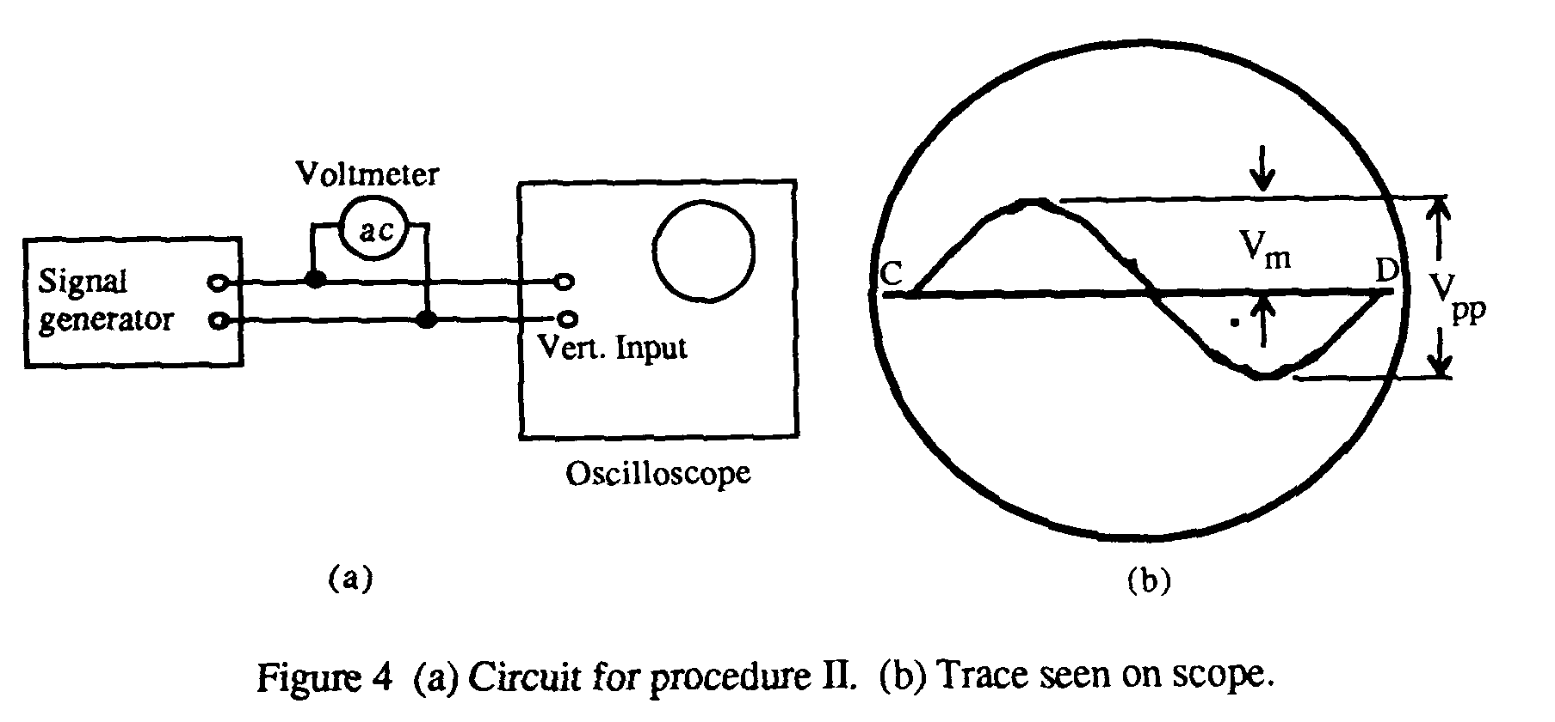

Slide 50
Applications of a CRO
As stated earlier, no other instrument in electronic industry is as versatile as a CRO. In fact, a modern oscilloscope is the most useful single piece of electronic equipment that not only removes guess work from technical troubleshooting but makes it possible to determine the trouble quickly.
Some of its uses are as under:
(a) In Radio Work
1. to trace and measure a signal throughout the RF, IF and AF channels of radio and television receivers.
2. it provides the only effective way of adjusting FM receivers, broadband high-frequency RF amplifiers and automatic frequency control circuits;
3. to test AF circuits for different types of distortions and other spurious oscillations;
4. to give visual display of wave shapes such as sine waves, square waves and their many different combinations;
5. to trace transistor curves
6. to visually show the composite synchronized TV signal
7. to display the response of tuned circuits etc.

Slide 51
(b) Scientific and Engineering Applications
1. measurement of ac/dc voltages,
2. finding B/H curves for hysteresis loop,
3. for engine pressure analysis,
4. for study of stress, strain, torque, acceleration etc.,
5. frequency and phase determination by using Lissajous Figures,
6. radiation patterns of antenna,
7. amplifier gain,
8. modulation percentage,
9. complex waveform as a short-cut for Fourier analysis,
10. Standing waves in transmission lines etc.

Slide 52
CATHODE RAY TUBE

Slide 54
What is CRT?
The CRT is a display screen which produces images in the form of the video signal.
It is a type of vacuum tube which displays images when the electron beam through electron guns are strikes on the phosphorescent surface.
In other Words, the CRT generates the beams, accelerates it at high velocity and deflect it for creating the images on the phosphorous screen so that the beam becomes visible.

Slide 55
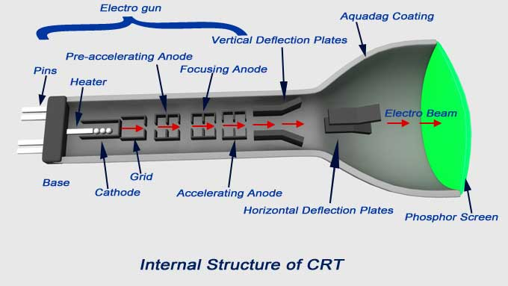
The main part of cathode ray oscilloscope is cathode ray tube which is also known as the heart of cathode ray oscilloscope.

Slide 56
3.1.2 Cathode Ray Tube (CRT)
A cathode ray tube (CRT) much like a television tube provides the visual display showing the form of signal applied as a waveform on the front screen. The CRT is the heart of the CRO providing visual display of an input signal waveform. A CRT contains four basic parts:
1. An electron gun to provide a stream of electrons.
2. Focusing and accelerating elements to produce a well define beam of electrons.
3. Horizontal and vertical deflecting plates to control the path of the electron beam.
4. An evacuated glass envelope with a phosphorescent screen which glows visibly when struck by electron beam.

Slide 60
1. Electron Gun Assembly
The electron gun is the source of the electron beams. The electron gun assembly shown in Fig. 7.6. It consists of an indirectly-heated cathode K, a control grid G, a pre-accelerator anode A1, focusing anode A2 and an accelerating anode A3. We will discuss each part of electron gun one by one in following:
(a) Cathode K. The sole function of the electrons gun assembly is to provide a focused beam of electrons which is accelerated towards the fluorescent screen. The electrons are given off by thermionic emission from the cathode.
The electron gun assembly consists of an indirectly-heated cathode K. A heated cathode emits electrons, which are accelerated to the first accelerating anode through a small hole in the control grid

Slide 62
(b) Control Grid. The control grid is a metallic cylinder with a small aperture in line with the cathode and kept at a negative potential with respect to K. The number of electrons allowed to pass through the grid aperture (and, hence, the beam current) depends on the amount of the control grid bias. Since the intensity (or brightness) of the spot S on the screen depends on the strength of beam current, the knob controlling the grid bias is called the intensity control.
(c) Accelerating Anode. The anodes A1 and A3 are the accelerating anode. The Anode A1 is the pre-accelerating anode. The pre-accelerating anode is a hollow cylinder that is at a potential a few hundred volts more positive than the cathode so that the electron beam will be accelerated in the electric field. Both the anode is at positive potential with respect to K. These anodes operate to accelerate the electron beam.

Slide 63
(d) Focusing Anode. The focusing anode ensures that electrons leaving the cathode in slightly different directions are focused down to a narrow beam and all arrive at the same spot on the screen. The cylindrical focusing anode A2, being at negative potential, repels electrons from all sides and compresses them into a fine beam. The knob controlling the potential of A2 provides the focus control.

Slide 64
2. Deflecting Plates
Two sets of deflecting plates are used for deflecting the thin pencil-like electronic beam both in the vertical and horizontal directions. Deflecting plates are:
Vertical Deflection Plates: These plates move the electron beam up and down the screen. The input signal is applied to these plates.
(b) Horizontal Deflection Plates: These plates move the electron bean by electrostatic attraction and repulsion, horizontally across the CRT screen
The first set marked Y (nearer to the gun) is for vertical deflection and X-set is for horizontal deflection. When no potential is applied across the plates, beam passes between both sets of plates undeflected and produces a bright spot at the centre of the screen.

Slide 65
If upper Y-plate is given a positive potential, the beam is deflected upwards depending on the value of the applied potential.
Similarly, the beam (and hence the spot) deflects downwards when lower Y-plate is made positive.
However, if an alternating voltage is applied across the Y-plates, the spot keeps moving up and down thereby producing a vertical luminous trace on the screen due to persistence of vision.
The maximum displacement of the spot from its central position is equal to the amplitude of the applied voltage.
The screen spot is deflected horizontally if similar voltages are applied to the X-plates. The dc potentials on the Y-and X-plates are adjustable by means of centering controls.

Slide 66
It must be remembered that the signal to be displayed on the screen is always applied across the Y-plates. The voltage applied across X-plates is a ramp voltage i.e. a voltage which increases linearly with time. It has a sawtooth wave-form as shown in Fig. 7.7. It is also called horizontal timebase or sweep voltage. It has a sweep time of Tsw

Slide 67
3. Glass Envelope
It is funnel-shaped having a phosphor-coated screen at its flared end. It is highly-evacuated in order to permit the electron beam to traverse the tube easily.
The inside of the flared part of the tube is coated with a conducting graphite layer called Aquadag which is maintained at the same potential as A3.
The bombarding electrons striking the phosphor release secondary-emission electrons, thus keeping the screen in a state of electrical equilibrium.
These secondary-emission low velocity electrons are collected by aquadag, which is electrically connected to the secondary anode.

Slide 68
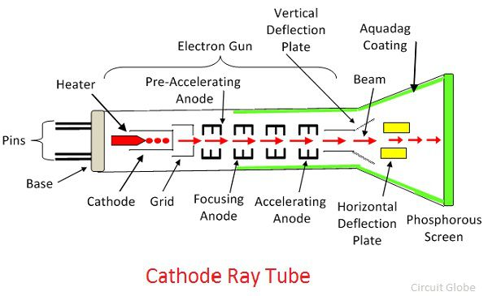

Slide 69
Functions of Aquadag are:
(i) It accelerates the electron beam after it passes between the deflecting plates
(ii) Collects the electrons produced by secondary emission when electron beam strikes the screen.
Hence, it prevents the formation of negative charge on the screen.

Slide 70
4. Graticules
The graticule is a grid of squares that serve as reference marks for measuring the displayed trace.
It is the calibrated horizontal and vertical marks are placed on the cathode ray tube screen to facilitate the use of the oscilloscope. It is a grid of lines that serves as a scale when making time and amplitude measurements.
The accuracy of these marks depends on how close the graticule marks can be placed to the actual phosphor to eliminate parallax. These are three types i.e external, internal and projected.

Slide 71
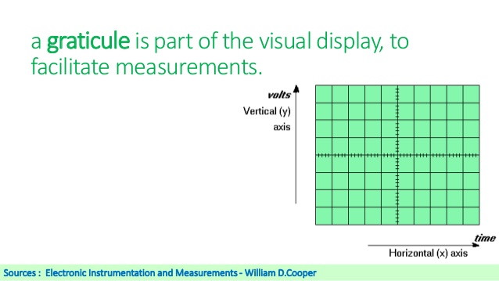

Slide 72
(a) External Graticule. This is scribed on a Plexiglas plastic and fixed to the screen. The distance between the marks on the graticule and the actual phosphor coating could be nearly 1 cm, which caused measurement errors if not used carefully.
(b) Internal Graticule. The graticule lines are etched (marked) on the inner surface of the front glass of the cathode ray tube. The distance of separation of phosphor and the graticule is nearly zero and parallax errors are practically nonexistent.
(c) Projected Graticule. It provides flexibility which can include additional features such as legends on the glass.

Slide 73
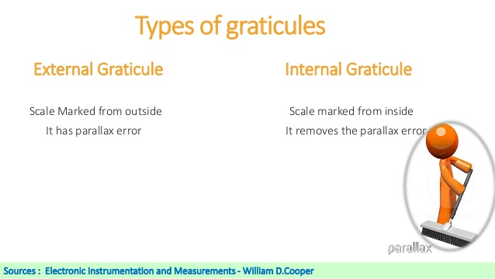

Slide 74
Working of Cathode Ray Tube
As the cathode is heated, it produces a large number of electrons.
These electrons pass through the control grid on their way to the screen.
The control grid controls the amount of current flow as in standard vacuum tubes.
If negative potential on the control grid is high, fewer electrons will pass through it.
Hence the electron beam will produce a dim spot of light on striking the screen. Reverse will happen when the negative potential on the control grid is reduced.

Slide 76
Therefore, the intensity of the light spot on the screen can be controlled by changing the negative potential on the control grid.
After leaving the control grid, the electron beam comes under the influence of focusing and accelerating anodes.
Since, the two anodes are at high positive potential, therefore, they produce a field which acts as electrostatic lens to converge the electron beam at a point on the screen.

Slide 77
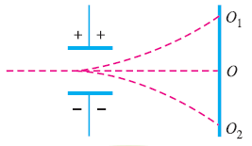
After leaving the accelerating anode, the electron beam comes under the influence of vertical and horizontal deflection plates.
When no voltage is applied to these deflection plates, the electron beam produces a spot of light at the centre as shown by point O in fig below on the screen.

Slide 78
If the voltage is applied to the vertical deflection plates only, the electron beam and so as the spot of light will be deflected upwards i.e. point O1. And if the potential on the plates is reversed, the spot of light will be deflected downwards i.e. point O2.
Similarly, the spot of light can be deflected horizontally by applying voltage across the horizontal deflection plates.

Slide 79
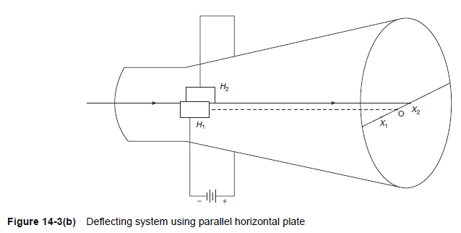
Deflection Systems:
To deflect the beam horizontally, an alternating voltage is applied to the horizontal deflecting plates and the spot on the screen moves horizontally, as shown in Fig. 14-3(b).
The electrons will focus at point X2. By changing the polarity of voltage, the beam will focus at point X1. Thus, the horizontal movement is controlled along X1OX2 line.

Slide 80
Deflection Systems:
Electrostatic deflection of an electron beam is used in a general purpose oscilloscope. The deflecting system consists of a pair of horizontal and vertical deflecting plates.
Let us consider two parallel vertical deflecting plates P1 and P2. The beam is focused at point O on the screen in the absence of a deflecting plate voltage.
If a positive voltage is applied to plate P1 with respect to plate P2, the negatively charged electrons are attracted towards the positive plate P1, and these electrons will come to focus at point Y1 on the fluorescent screen.

Slide 81
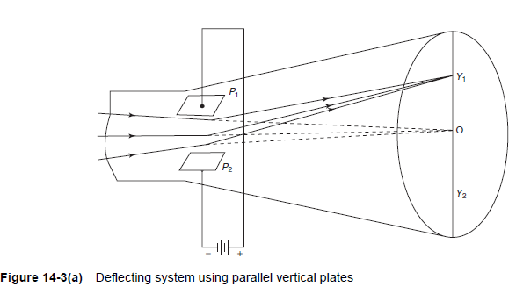
Deflection Systems:
The deflection is proportional to the deflecting voltage between the plates. If the polarity of the deflecting voltage is reversed, the spot appears at the point Y2, as shown in Fig. 14-3(a).

Slide 82
Electrostatic Focusing
In a cathode ray tube number of electrons is projected by the gun in the form of electron beam towards the screen.
But due to variation of energy the electrons diverge and cannot produce spot on the screen. So we use electrostatic focusing method for projection of electron beam.
In electrostatic focusing two parallel deflecting plates are used. These are spaced at a distance d from each other.
The plates are at potential difference Vd due to this potential difference electric field E exist between the two plates. The electrons from the cathode are accelerated towards the anode by the potential Vd.

Slide 83
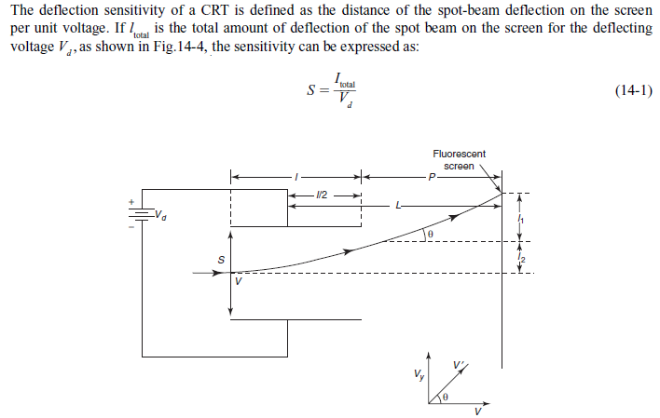
Spot Beam Deflection Sensitivity:

Slide 90
Fluorescent Screen:
Phosphor is used as screen material on the inner surface of a CRT. Phosphor absorbs the energy of the incident electrons. The spot of light is produced on the screen where the electron beam hits.
The bombarding electrons striking the screen, release secondary emission electrons. These electrons are collected or trapped by an aqueous solution of graphite called “Aquadag” which is connected to the second anode.
Collection of the secondary electrons is necessary to keep the screen in a state of electrical equilibrium.
The type of phosphor used, determines the color of the light spot. The brightest available phosphor isotope, P31, produces yellow–green light with relative luminance of 99.99%.

Slide 91
The screen of the CRT is coated with a natural or synthetic phosphor that emits visible light when the electron beam impinges on it.
The phosphor tends to absorb the kinetic energy of the impinging electron beam and re-emits the same absorbed energy in the visible spectrum (400 – 700 nm).
This phenomenon of certain materials to emit energy in the visible range after absorbing energy or being stimulated by radiation is referred to as Fluorescence.

Slide 92
Fluorescent materials sometimes also possess a secondary property called Phosphorescence wherein they continue to emit light even after the source of excitation is removed.
The length of time during which ‘afterglow’ or Phosphorescence occurs is popularly referred to as Persistence of the phosphor.
Luminance is another property of the phosphor that gives an idea about the intensity of light emitted from the phosphor.
Some of the standard phosphor types include materials including Zn2SiO4:Mn [Green, 528 nm],
ZnS:Cu(Ag)(B*) [Blue-Green, 543 nm], Zn8:BeSi5O19:Mn [Yellow, 602 nm] etc.
The type of phosphor controls the type of signal whether fast or slow can be seen on the CRT screen

Slide 93
Normal Operation of CRO
The signal to be viewed or displayed on the screen is applied across the Y-plates of a CRT. But to see its waveform or pattern, it is essential to spread it out horizontally from left to right. It is achieved by applying a sawtooth voltage wave (produced by a time base generator) to X-plates.
Under these conditions, the electron beam would move uniformly from left to right thereby graphic vertical variations of the input signal versus time. Due to repetitive tracing of the viewed waveform, we get a continuous display because of persistence of vision.
However, for getting a stable stationary display on the screen, it is essential to synchronize the horizontal sweeping of the beam (sync) with the input signal across Y-plates.
The signal will be properly synced only when its frequency equals the sweep-generator frequency.

Slide 94
In general, for proper synchronization of time-base with the signal, the condition is
where Ts the time-period of the signal and n is an integer.
If n = 1, then Tsw = Ts i.e. time-periods of the sweep voltage and input signal voltage are equal, then one cycle of the signal would be displayed as shown in Fig. 7.11(a).
On the other hand, if Tsw is twice Ts, then two cycles of the signal voltage would be displayed as shown in Fig. 7.11(b) obviously, three full cycles of the input voltage would be spread out on the screen when Tsw = 3Ts.

Slide 96
Internal Synchronization
The periodic sawtooth voltage which is applied to X-plates for horizontal sweep (or scan) of the beam across the screen is usually provided by the unijunction relaxation oscillator.
When the sawtooth voltage falls abruptly to zero, the beam experiences no horizontal deflection and hence flies back almost instantly to the original (central) position.
The usual method of synchronizing the input signal is to use a portion of the input signal to trigger the sweep generator so that the frequency of the sweep signal is locked or synchronized to the input signal.
It is called internal sync. because the synchronization is obtained by internal wiring connection as shown in the block diagram of Fig. 7.12.

Slide 98
Oscilloscope Amplifiers
The voltage applied to the inputs of an oscilloscope is very small to cause any noticeable deflection of the electron beam in the screen. Therefore before applying any voltage direct to the plates, the input voltages are first feed to the amplifier which increases their magnitude.
The amount of amplification which each amplifier provides is selected by the sensitivity controls of the oscilloscope. To make the oscilloscope versatile, the sensitivity control is designed to be a wide range of discrete amplification levels. These levels are calibrated to produce the level of amplification specified by the control setting. Oscilloscope amplifiers are of following two types:
1. Vertical Amplifier
2. Horizontal Amplifier

Slide 99
Vertical Amplifier
The vertical amplifier is the principle factor in determining the sensitivity and bandwidth of an oscilloscope. The block diagram of vertical deflection is shown in Fig. 7.13. The input signal is not so strong to provide the measurable deflection on the screen. Vertical amplifier stage is used to amplify the input signals.

Slide 100
The input signal is feeds an input attenuator. After which follows the vertical amplifier. The amplifier stages used are generally wide band amplifiers so as to pass faithfully the entire band of frequencies to be measured. The amplifier can be designed for stability.

Slide 101
Attenuators
An attenuator is an electronic device that reduces the amplitude or power of a signal without distorting its waveform.
The voltage at the input terminal of the vertical amplifier is quite low in amplitude so it deflected off the CRT screen. So high input signals may be applied. An attenuator network is placed between the vertical input terminal and the input terminal of the vertical amplifier.
The purpose of the attenuator is to reduce the amplitude of the vertical input signal before applying it to the vertical amplifier. An attenuator is a simple resistive voltage divider connected to an amplifier with a 10 pF input capacitance. If the impedance of the amplifier is high, the input impedance of the attenuator is relativity constant, immaterial of the switch setting of the attenuator.

Slide 102
The input impedance, as seen by the amplifier, changes greatly depending on the setting of the attenuator. Because of this, the RC time constant and frequency of the amplifier are dependent on the setting of the attenuator.
There are two types of attenuators, uncompensated and compensated attenuators.

Slide 103
Horizontal Deflection Amplifier
The oscilloscopes deflect the horizontal portion of the trace at a constant rate relative to time. This is referred to as linear sweep. The horizontal deflection system consists of
1.Trigger Circuit. The trigger circuit insures that the horizontal sweep starts at the same point of the vertical input signal.
2. Sweep Generator or Time Base Generator. The detail of the sweep generator is discuss in next article
3. Horizontal Amplifier

Slide 104
The function of the horizontal amplifier is given below:
1. The function of the horizontal amplifier is to amplify the signal applied to the X-plates.
2. When the oscilloscope is being used in the ordinary mode of operation to display a signal applied to the vertical input, the horizontal amplifier will amplify the sweep generator input.
3. When the oscilloscope is being used in the X-Y mode, the signal applied to the horizontal input terminal will be amplified by the horizontal amplifier.

Slide 105
Sweep Generator
In such circuits, either the output voltage (or the output current) is a linear function of time, over a specified time interval. This circuit is also known as time base circuits or time base generators.
These circuits are extremely important in most of the electronic systems. A linear time base voltage is required on the deflection plates of cathode ray oscilloscope, to sweep the electron beam, from left to right across the screen.
Similarly, a linear time base current waveform is required in the deflection coils of a television receiver.
Because of the sweep application, the circuits are also sometimes known as sweep circuits (or sweep generators).

Slide 106
Fig. 7.16 (a) shows a typical time base signal. Here the voltage starts from some initial value as indicated by point A in the Figure.
Then it increases linearly with time to a maximum value indicated by point B in the Figure. After this, the voltage returns back to its initial value as indicated by point C in the Figure.
The time, required by the voltage from its initial value to reach its maximum value, is known as sweep time and is designated by the symbol Ts.
Similarly, the time taken by the voltage to its initial value is called a restoration time and is designated by the symbol Tr. The restoration time is also known as return time or the flyback time

Slide 107
In most of the applications, the shape of the waveform during the restoration time, as well as the restoration time itself, is of no importance. However, in certain applications, it is desired that the restoration time is very short in comparison with the time occupied by the linear portion of the waveform (i.e., Tr << Ts).
In that case, the restoration time is extremely short and a new voltage is initiated at the instance the previous one is terminated. The waveform, in such a case, is as shown in Fig. 7.16 (b) and is known as sawtooth waveform.
It is customary to refer to waveforms shown in Fig. 7.16 (a) and (b) as sweep waveforms even in applications not involving the deflection of an electron beam.

Slide 108
Sweep Circuit
Fig. 7.18 (a) shows the basic circuit of a transistor switch sweep circuit. This circuit requires a gating waveform (vi) as shown in Fig. 7.18 (b).
It may be obtained from a monostable multivibrator (i.e., one shot) or an astable multivibrator. If the ‘gating’ waveform is obtained from a monostable multivibrator, the sweep generated by the circuit is called triggered sweep and the circuit is known as triggered voltage time base generator. However, if the ‘gating’ waveform is obtained from an astable multivibrator, the sweep generated is called free running sweep and the circuit is known as free running voltage time base generator.

Slide 109
Initially, the transistor is biased ON and operates in the saturation region.
Thus when there is no input (i.e., vi = 0), the output voltage is zero. (Actually its value is equal to VCE (sat)). When the ‘gating’ pulse (i.e., a negative pulse) is applied, the transistor turns OFF. As a result of this, the capacitor voltage rises to a target value VCC with a time constant RC* C. The charging curve ignoring VCE (sat) is governed by relation,

Slide 112
It is evident from the above relation that the output or sweep voltage level (Vs) must be a small fraction of the supply voltage (VCC) and this is not a desirable feature, if a certain sweep voltage level is desired. This shortcoming can be remedied by the Miller sweep and the Bootstrap sweep circuits.

Slide 113
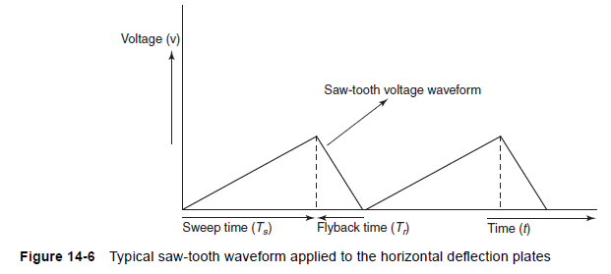
TIME-BASE GENERATORS:
The CRO is used to display a waveform that varies as a function of time. If the wave form is to be accurately reproduced, the beam should have a constant horizontal velocity.
As the beam velocity is a function of the deflecting voltage, the deflecting voltage must increase linearly with time.
A voltage with such characteristics is called a ramp voltage. If the voltage decreases rapidly to zero—with the waveform repeatedly produced, as shown in Fig. 14-6—we observe a pattern which is generally called a saw-tooth waveform.
The time taken to return to its initial value is known as flyback or return time.

Slide 114
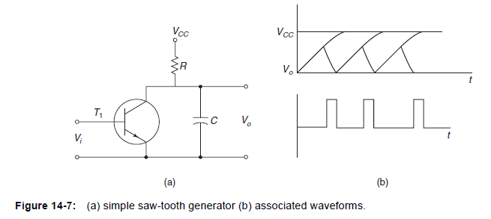
Simple saw-tooth generator & associated waveforms:
The circuit shown in Fig. 14-7(a) is a simple sweep circuit, in which the capacitor C charges through the resistor R.
The capacitor discharges periodically through the transistor T1, which causes the waveform shown in Fig. 14-7(b) to appear across the capacitor.
The signal voltage, Vi which must be applied to the base of the transistor to turn it ON for short time intervals is also shown in Fig. 14-7(b).

Slide 115
Delay Line
Both the horizontal sweep and vertical deflection information should arrive at the CRT at the same time.
If they do not, the scope cannot display the voltage information properly. Since the delays in the horizontal path are longer, vertical information reaches the CRT before the horizontal information.
The solution to the problem is to put a calibrated delay into the vertical path so that both horizontal and vertical signals reach the CRT at the same time.
The delay line is used to delay the signal for some time in the vertical section. The horizontal signal (time base, or sweep voltage) is initiated or trigger by a portion of the output signal applied to the vertical CRT plates.

Slide 116
Signal processing in the horizontal channel consists of generating and shaping a trigger pulse that starts the sweep generator. The output is then feed to the horizontal amplifier and then to the horizontal deflection plates. This whole process takes time about 80 ns or more.

Slide 117
To display the waveform, the signal for the vertical CRT plates must be delayed by at least the same amount of time.
This is the function of the vertical delay circuit. From Fig. 7.19 we observe that a 200 ns delay has been added to the vertical channel so that the signal voltage to the CRT plates is delayed by 200 ns, and the horizontal sweep is started prior to the vertical deflection.
There are two kinds of delay line:
1. The lumped-parameter delay line
2. The distributed-parameter delay line.

Slide 140
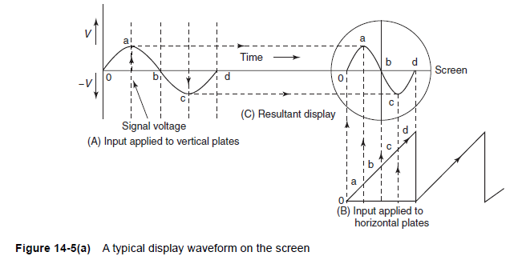
Display waveform on the screen:
Figure 14-5(a) shows a sine wave applied to vertical deflecting plates and a repetitive ramp or saw-tooth applied to the horizontal plates.
The ramp waveform at the horizontal plates causes the electron beam to be deflected horizontally across the screen.
If the waveforms are perfectly synchronized then the exact sine wave applied to the vertical display appears on the CRO display screen.

Slide 141
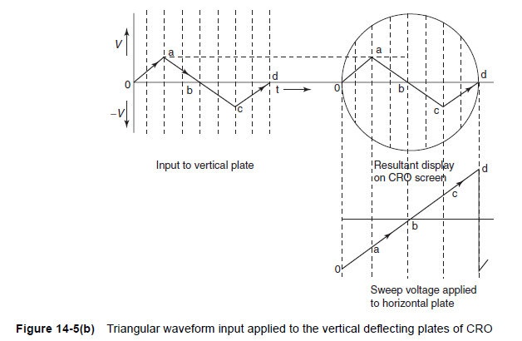
Triangular waveform:
Similarly the display of the triangular waveform is as shown in Fig. 14-5(b).

Slide 142
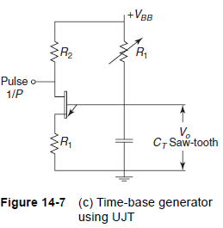
Time-base generator using UJT:
The continuous sweep CRO uses the UJT as a time-base generator. When power is first applied to the UJT, it is in the OFF state and CT changes exponentially through RT .
The UJT emitter voltage VE rises towards VBB and VE reaches the plate voltage VP.
The emitter-to-base diode becomes forward biased and the UJT triggers ON. This provides a low resistance discharge path and the capacitor discharges rapidly.
When the emitter voltage VE reaches the minimum value rapidly, the UJT goes OFF. The capacitor recharges and the cycles repeat.
To improve the sweep linearity, two separate voltage supplies are used; a low voltage supply for the UJT and a high voltage supply for the RTCT circuit. This circuit is as shown in Fig. 14-7(c).
RT is used for continuous control of frequency within a range and CT is varied or changed in steps. They are sometimes known as
timing resistor and timing capacitor.

Slide 143
Trigger (Sync.) Circuit:
A sample of the input waveform is fed to a trigger circuit which produces a trigger pulse at some selected point on the input waveform. This trigger pulse is used to start the time base generator which then starts the horizontal sweep of CRT spot from left hand side of the screen.
Time base (Sweep) Generator:
This produces a saw – tooth waveform that is used as horizontal deflection voltage of CRT. The rate of rise of positive going part of sawtooth waveform is controlled by TIME/DIV knob. The sawtooth voltage is fed to the horizontal amplifier if the switch is in INTERNAL position. If the switch is in EXT. position, an external horizontal input can be applied to the horizontal amplifier.

Slide 144
Vertical Amplifier:
The input signal is applied to vertical amplifier. The gain of this amplifier can be controlled by VOLT/DIV knob. Output of this amplifier is applied to the delay line.
Delay Line:
The delay Line retards the arrival of the input waveform at the vertical deflection plates until the trigger and time base circuits start the sweep of the beam. The delay line produces a delay of 0.25 microsecond so that the leading edge of the input waveform can be viewed even though it was used to trigger the sweep.

Slide 145
Horizontal Amplifier:
This amplifies the saw – tooth voltage. As it includes a phase inverter two outputs are produced. Positive going sawtooth and negative going sawtooth are applied to right – hand and left – hand horizontal deflection plates of CRT.
Blanking Circuit:
The blanking circuit is necessary to eliminate the retrace that would occur when the spot on CRT screen moves from right side to left side” This retrace can cause confusion if it is not eliminate. The blanking voltage is produced by sweep generator. Hence a high negative voltage is applied to the control grid during retrace period or a high positive voltage is applied to cathode in CRT.

Slide 146
Oscilloscope Amplifiers:
The purpose of an oscilloscope is to produce a faithful representation of the signals applied to its input terminals.
Considerable attention has to be paid to the design of these amplifiers for this purpose. The oscillographic amplifiers can be classified into two major categories.
(i) AC-coupled amplifiers
(ii) DC-coupled amplifiers
The low-cost oscilloscopes generally use ac-coupled amplifiers. The ac amplifiers, used in oscilloscopes, are required for laboratory purposes. The dc-coupled amplifiers are quite expensive. They offer the advantage of responding to dc voltages, so it is possible to measure dc voltages as pure signals and ac signals superimposed upon the dc signals.
DC-coupled amplifiers have another advantage. They eliminate the problems of low-frequency phase shift and waveform distortion while observing low-frequency pulse train.
The amplifiers can be classified according to bandwidth use also:
(i) Narrow-bandwidth amplifiers
(ii) Broad-bandwidth amplifiers

Slide 147
Vertical Amplifiers:
Vertical amplifiers determines the sensitivity and bandwidth of an oscilloscope. Sensitivity, which is expressed in terms of V/cm of vertical deflection at the mid-band frequency.
The gain of the vertical amplifier determines the smallest signal that the oscilloscope can satisfactorily measure by reproducing it on the CRT screen.
The sensitivity of an oscilloscope is directly proportional to the gain of the vertical amplifier. So, as the gain increases the sensitivity also increases.
The vertical sensitivity measures how much the electron beam will be deflected for a specified input signal. The CRT screen is covered with a plastic grid pattern called a graticule.
The spacing between the grids lines is typically 10 mm. Vertical sensitivity is generally expressed in volts per division.
The vertical sensitivity of an oscilloscope measures the smallest deflection factor that can be selected with the rotary switch.

Slide 148
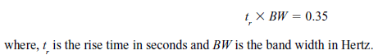
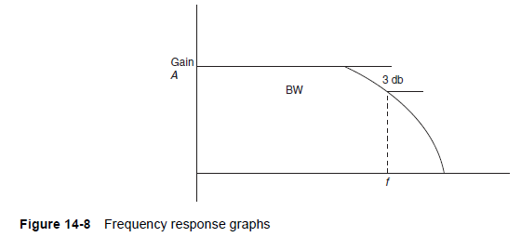
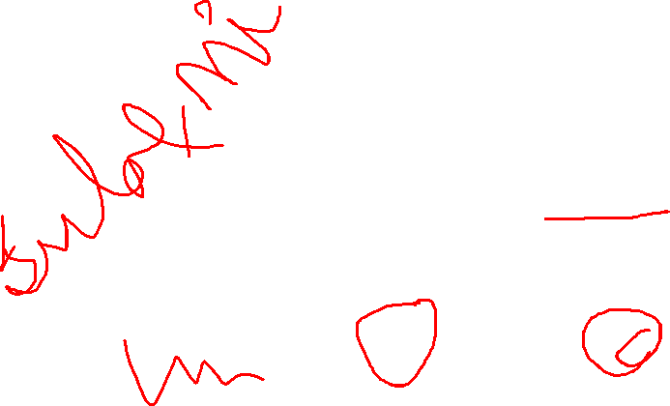
Frequency response:
The bandwidth of an oscilloscope detects the range of frequencies that can be accurately reproduced on the CRT screen. The greater the bandwidth, the wider is the range of observed frequencies.
The bandwidth of an oscilloscope is the range of frequencies over which the gain of the vertical amplifier stays within 3 db of the mid-band frequency gain, as shown in Fig. 14-8.
Rise time is defined as the time required for the edge to rise from 10–90% of its maximum amplitude. An approximate relation is given as follows:

Slide 149
Frequency response:
The bandwidth of an oscilloscope detects the range of frequencies that can be accurately reproduced on the CRT screen. The greater the bandwidth, the wider is the range of observed frequencies.
The bandwidth of an oscilloscope is the range of frequencies over which the gain of the vertical amplifier stays within 3 db of the mid-band frequency gain, as shown in Fig. 14-8.
Rise time is defined as the time required for the edge to rise from 10–90% of its maximum amplitude. An approximate relation is given as follows:

Slide 150
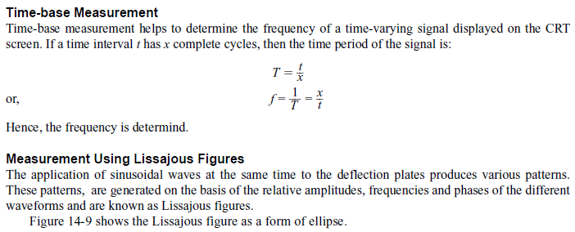
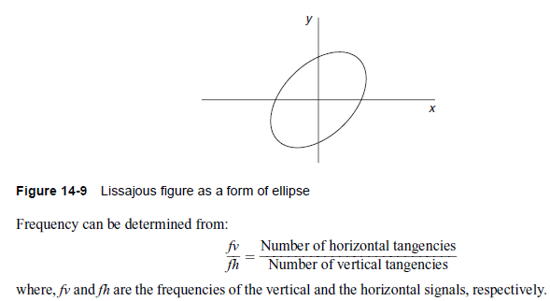
MEASUREMENTS USING THE CATHODE-RAY OSCILLOSCOPE:
1) Measurement of Frequency:

Slide 151
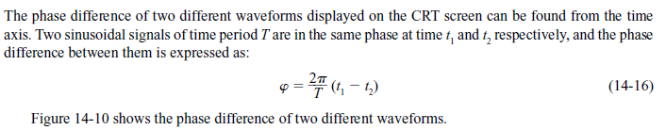
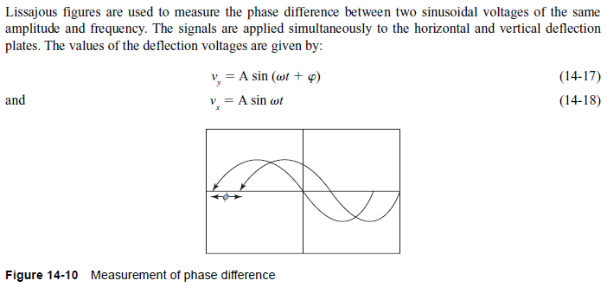
MEASUREMENTS USING THE CATHODE-RAY OSCILLOSCOPE:
2) Measurement of Phase:
3 Measurement of Phase Using Lissajous Figures:

Slide 152
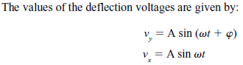
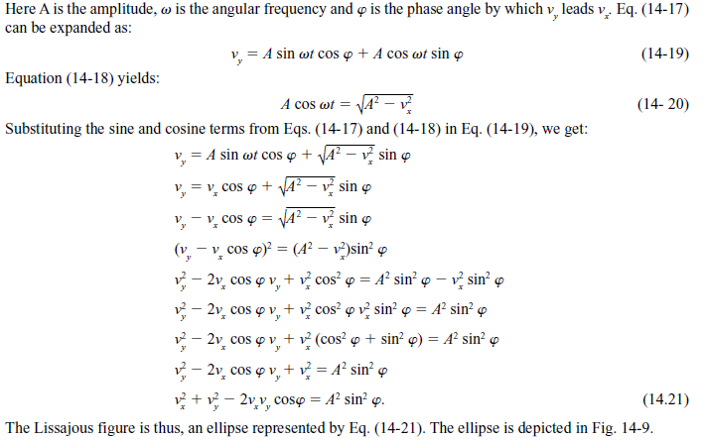
Measurement of Phase Using Lissajous Figures:

Slide 153
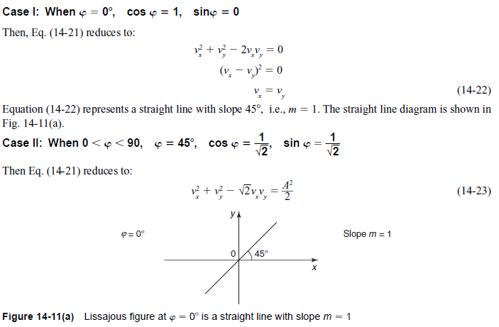
Measurement of Phase Using Lissajous Figures:

Slide 154
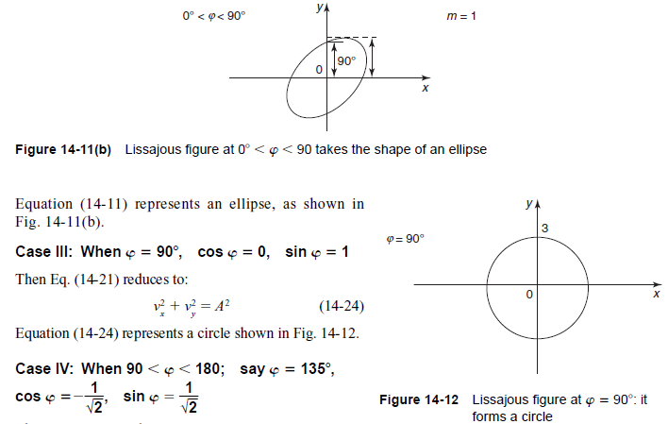
Measurement of Phase Using Lissajous Figures:

Slide 155
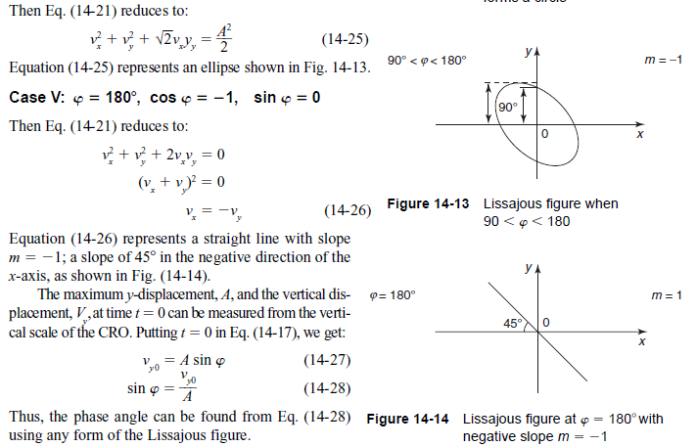
Measurement of Phase Using Lissajous Figures:

Slide 156
TYPES OF THE CATHODE-RAY OSCILLOSCOPES:
The categorization of CROs is done on the basis of whether they are digital or analog. Digital CROs can be further classified as storage oscilloscopes.
1. Analog CRO: In an analog CRO, the amplitude, phase and frequency are measured from the displayed waveform, through direct manual reading.
2. Digital CRO: A digital CRO offers digital read-out of signal information, i.e., the time, voltage or frequency along with signal display. It consists of an electronic counter along with the main body of the CRO.
3. Storage CRO: A storage CRO retains the display up to a substantial amount of time after the first trace has appeared on the screen. The storage CRO is also useful for the display of waveforms of low-frequency signals.
4. Dual-Beam CRO: In the dual-beam CRO two electron beams fall on a single CRT. The dual-gun CRT generates two different beams.
These two beams produce two spots of light on the CRT screen which make the simultaneous observation of two different signal waveforms possible. The comparison of input and its corresponding output becomes easier using the dual-beam CRO.

Slide 157
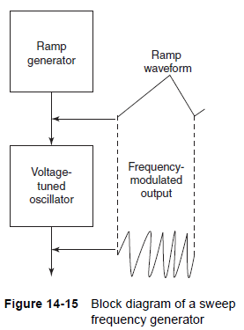
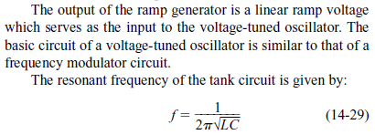
SWEEP FREQUENCY GENERATOR:
A sweep frequency generator is a signal generator which can automatically vary its frequency smoothly and continuously over an entire frequency range. Figure 14-15 shows the basic block diagram of a sweep frequency generator.
The sweep frequency generator has the ramp generator and the voltage-tuned oscillator as its basic components.

Slide 158
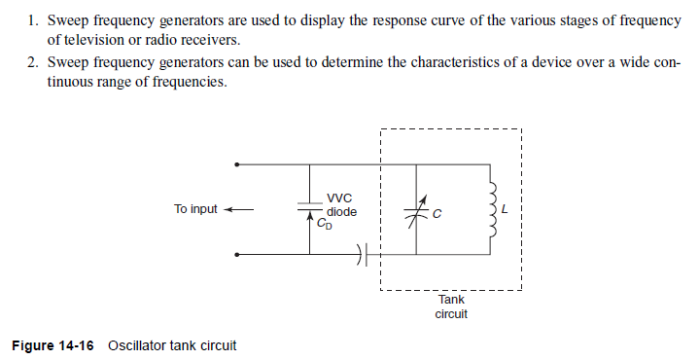
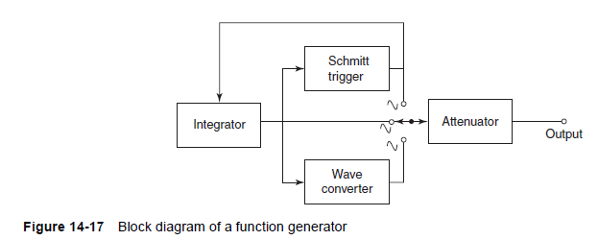
Applications of the Sweep Frequency Generator:

Slide 159
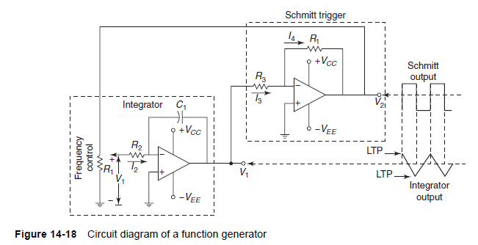
FUNCTION GENERATOR:
The basic components of a function generator are:
(i) Integrator
(ii) Schmitt trigger circuit
(iii) Sine wave converter
(iv) Attenuator

Slide 160
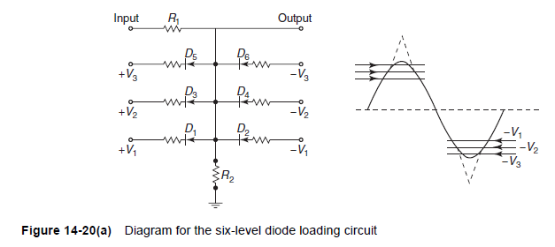
SINE WAVE GENERATOR:
The approximation may be further improved by employing a six-level diode loading circuit, as shown in Fig. 14-20(a).

Slide 161
SINE WAVE GENERATOR:
The approximation may be further improved by employing a six-level diode loading circuit, as shown in Fig. 14-20(a).

Slide 162
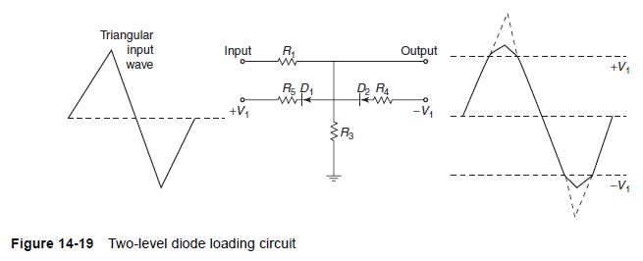
SINE WAVE GENERATOR:
A sine wave is produced by converting a triangular wave, applying proper circuits. The triangular wave is produced by employing an integrator and a Schmitt trigger circuit.
This triangular wave is then converted to a sine wave using the diode loading circuit ,as shown in Fig. 14-19. Resistors R1 and R2 behave as the voltage divider. When VR2 exceeds V1, the diode D1 becomes forward-biased.
There is more attenuation of the output voltage levels above V1 than levels below V1. With the presence of the diode D1 and resistor R3 in the circuit, the output voltage rises less steeply.
The output voltage falls below V1 and the diode stops conducting, as it is in reverse-bias. The circuit behaves as a simple voltage-divider circuit. This is also true for the negative half-cycle of the input Vi . If R3 is carefully chosen to be the same as R4 , the negative and the positive cycles of the output voltage will be the same. The output is an approximate sine wave.

Slide 163
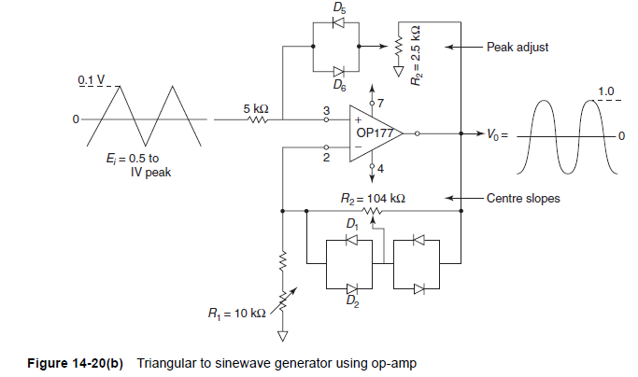
SINE WAVE GENERATOR:
The circuit is adjusted by comparing a 1 kHz sine wave and the output of the triangular/sine wave converter on a dual-track CRO. R1, R2, R3 and the peak amplitude of Ei are adjusted in sequence for the best sinusoidal shape.

Slide 164
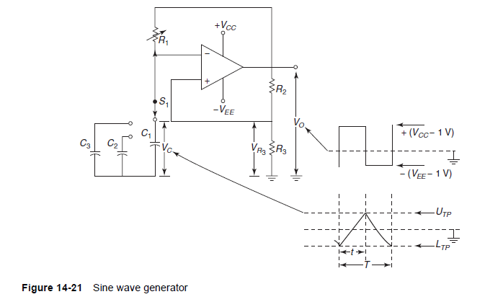
CIRCUIT DIAGRAM OF SINE WAVE GENERATOR:

Slide 165
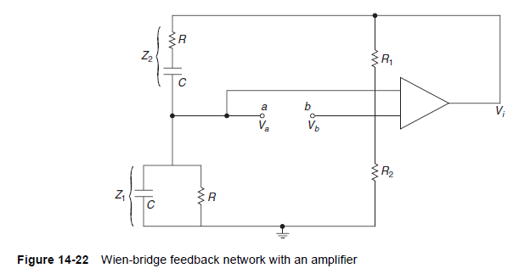
SQUARE WAVE GENERATOR
A square wave can be most easily obtained from an operational amplifier astable multi-vibrator. An astable multi-vibrator has no stable state—the output oscillates continuously between high and low states.
In Fig. 14-21, the block comprising the op-amp, resistors R2 and R3 constitutes a Schmitt trigger circuit. The capacitor C1 gets charged through the resistor R1. When the voltage of the capacitor reaches the upper trigger point of the Schmitt trigger circuit, the output of the op-amp switches to output low. This is because the Schmitt trigger is a non-inverting type. Now, when the op-amp output is low, the capacitor C1 starts getting discharged.

Slide 166
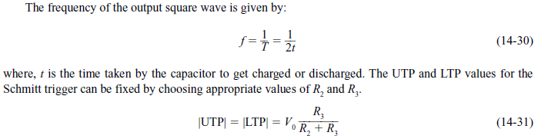
SQUARE WAVE GENERATOR:
As the capacitor discharges and the capacitor voltage reaches the lower trigger point of the Schmitt trigger, the output of the op-amp switches back to the output high state.
The capacitor charges through the resistor again and the next cycle begins. The process is repetitive and produces a square wave at the output.
The frequency of the output square wave depends on the time taken by the capacitor to get charged and discharged when the capacitor voltage varies from UTP (upper trigger point) and LTP (lower trigger point).

Slide 167
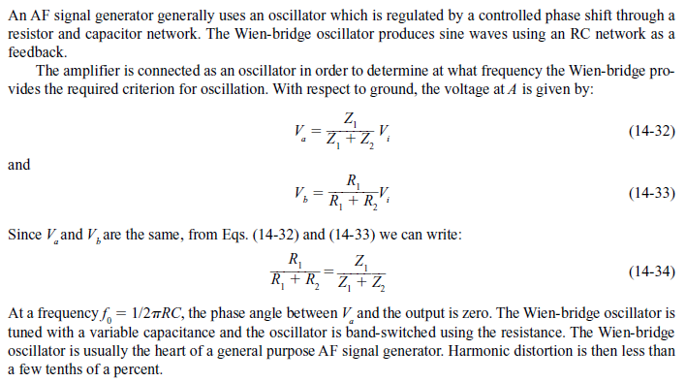
AF SIGNAL GENERATOR:

Slide 168
POINTS TO REMEMBER:
1. CRO is used to study waveforms.
2. CRT is the main component of a CRO.
3. Prosperous P31 is used for the fluorescent screen of a CRO.
4. A CRO has the following components:
(a) Electron gun
(b) Deflecting system
(c) Florescent screen
5. Lissajous figures are used to measure frequency and phase of the waves under study.
6. A time-base generator produces saw-tooth voltage.
7. An oscilloscope amplifier is used to provide a faithful representation of input signal applied to its input terminals.

Slide 169
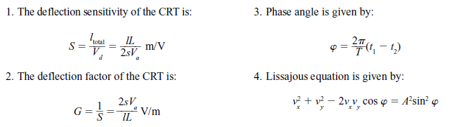
IMPORTANT FORMULAE:

Slide 171
analog oscilloscope | digital oscilloscope
Direcly reads analog voltage and displays it on screen. | It reads the analog voltage and converts it into digital form before being displayed on the screen.
Do not require ADC, microprocessor and acquision memory | Requires ADC, microprocessor and acquisition memory
Can only analyze signal in real time as there is no storage memory available. | Can analyze signal in real time as well as can analyze previously acquired large samples of data with facility of storage available.
Can not analyze high frequency sharp rise time transients | Can analyze high frequency transients due to advanced DSP algorithms available and ported on microprocessor which can operate on stored samples of input voltage.

